Slide 1
Reception
Hazel Class

Slide 2

Our Values
Honesty
Kindness
Respect
Notes:
Class agreements – show on display

Slide 3
The Early Years Foundation Stage
There are 7
areas of learning
Communication and Language
Personal, Social and Emotional
Development
Physical Development
Literacy
Understanding the World
Mathematics
Expressive Arts and Design
Notes:
3 primes
4 specific
Characteristics of Effective Learning – in classroom to develop positive learning behaviours
Creating and thinking critically
Active learning
Playing and exploring
So are the children problem solving, I they actively engaged in what they are doing, are they curious and inquisitive, having their own ideas etc
If the children develop these skills early on in lie it sets them up for success with their future learning

Slide 4
The story so far …
Notes:
Settling in, saying goodbye at the door, where do things go, transitions such as lunchtime
Routines and expectations, using our timetable, we can then use this to discuss the expectations at each point, how do we walk around the school, using our manners,
Using our values to promote expectations
Words to describe the children …Independence, resilience, persevering, brave, happy, busy, curious, thoughtful, fun, enjoyable

Slide 5
A day in the life of a Reception Child
Carry out our ‘jobs’
Access our colour group ‘busy fingers’ activities
Carpet time
Hello, register, days of the week, weather, sharing any news / tapestry posts
Phonics 20-30mins (Currently 10 minutes but will increase over the year)
Exploring – planning our learning to promote the CoEL
Snack time - leading to independent snack
Tidy up time
Prep for lunch
LUNCH!
Carpet time – topic or maths input
Exploring – Planning our learning to promote the CoEL
Tidy up time
Home time prep
Story and embed phonics learning
* CoEL - Characteristics of Effective Learning
Notes:
It is Busy!
Early in the term BF is linked to the children’s fine motor skills, to develop the dexterity on the hands
Ongoing we add links to maths, literacy, phonics etc
Carpet time.
Hello, register, days of the week, weather, sharing any news / tapestry posts
Phonics 20mins

Slide 6
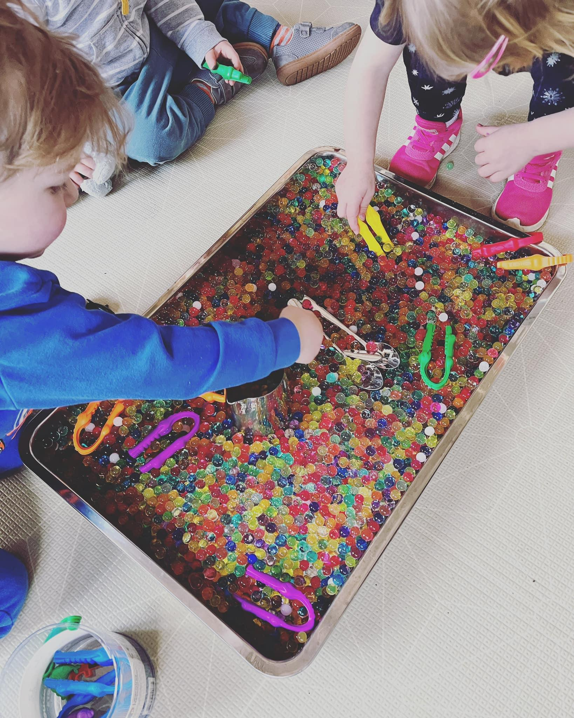
Learning in the Early Years
- Exciting environment
- Child initiated activities
- Adult led activities
- High quality interactions
- Observations
- Formative assessment
- Play!

Slide 7
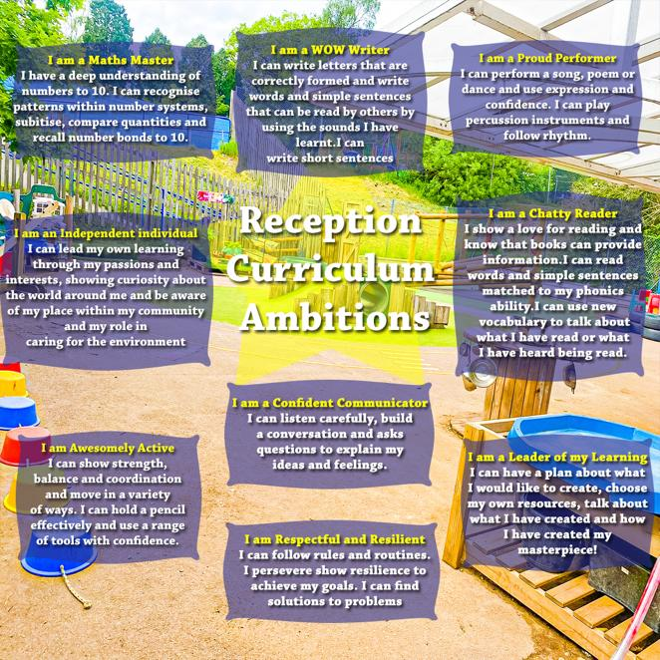

Slide 8

Phonics
https://www.littlewandlelettersandsounds.org.uk/resources/for-parents/
Notes:
Little Wandle – Validated by DfE – Systematic Synthetic Phonics
Aim of DfE to
give all children a solid base upon which to build as they progress through school
help children to develop the habit of reading widely and often, for both pleasure and information
Phases
Autumn 1 /2 pure sounds Phoneme – what you hear and the Grapheme what you see – letter formation
Spring 1 - Digraph 2 letters one sound
Half term – placement assessment is completed to match books to decoding level
Reading for pleasure
ELG

Slide 9
Books
Thursday– Library Day
Choose a book … Reading for Pleasure!
Thursday – Must have reading book in School.
Friday – New allocated reading book comes home – changed weekly – your child may be given the same book or they may be given a book they have already been given. This is to allow them to become secure in their phonics knowledge.
Notes:
Importance of picture / no word books – picture comprehension, enjoying looking at a book, discussing what they see, listening for initial sounds
Repetition
Books allocated and should be read at 90% fluency before moving on

Slide 10
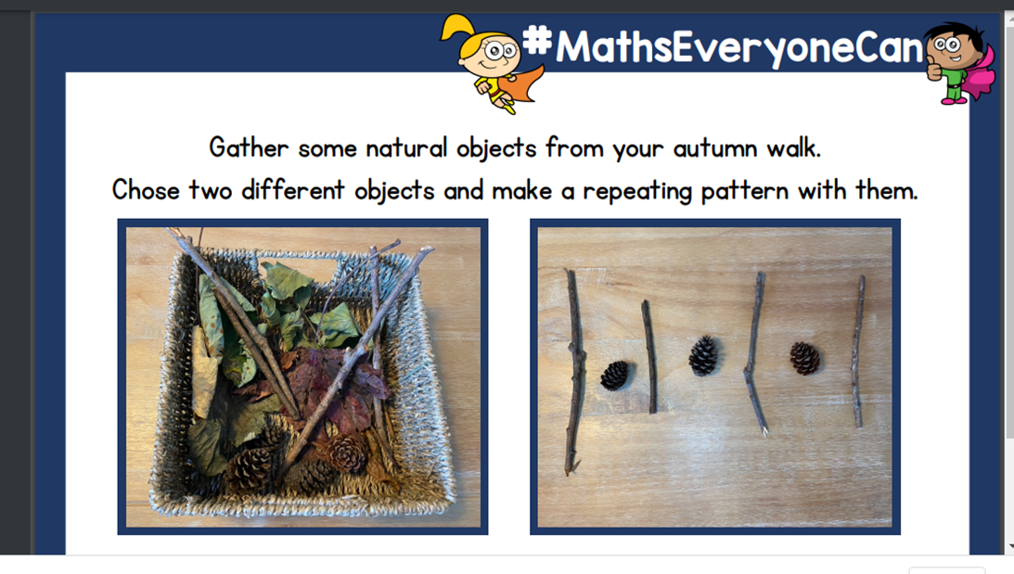
Maths
Notes:
White Rose Maths
Planning
Play to embed concepts
Subitising Skills are key
Subitising is an essential part of developing number sense in early years children by helping them to relate numbers to actual items or groups of items. This is known as number conservation. It is not uncommon that young children learn to count by rote but do not really understand the meaning behind what they are doing. By looking at groups of items, children can start to develop an understanding of how a number is made up: for example, seven dots could be a set of three dots and a set of four dots, or a set of six dots and one dot. This understanding of part-part-whole relationships helps children to separate and combine numbers and accelerates understanding of addition and subtraction.

Slide 11
How we observe and assess
Reception Baseline Assessment
Formative assessment – utilising all teachable moments
Summative Assessment
GLD predictors
ELGs
Notes:
RBA – statutory
In school baseline across all 7 areas
Half termly summative assessment
Formative assessment ongoing and used to inform planning
Intervention groups for support and stretch and challenge
Children are defined as having reached a Good Level of Development (GLD) at the end of the EYFS if they have achieved the expected level for the ELGs in the prime areas of learning (which are: communication and language; personal, social and emotional development; and physical development) and the specific areas of mathematics and literacy. 12 ELGs
GLD helps a child to make a good start when they enter year 1 and start the national curriculum

Slide 12
Partnership with Parents
Website, Tapestry
Information evenings
Parent consultations
Stay and Play - see it in action
PTA
Wish lists and donations

Slide 13
How you can help at home?
Phonics review work
Provide opportunities for chatting, playing and interacting together
Spend time together reading, telling stories and singing
Talk, Talk, Talk
Vocabulary
Play games that involve listening and turn taking
Encourage independence – getting dressed, putting on coat and shoes, washing/ drying hands and using the toilet

Slide 14
Thank you for attending

